Slide 1
Binary Arithmetic

Slide 2
Binary Addition
Rules of binary addition
0 + 0 =0
0 + 1 = 1
1 + 0 = 1
1 + 1 = 10
1 + 1 + 1 = 11

Slide 3
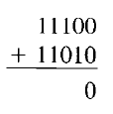
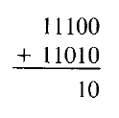
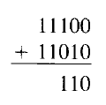
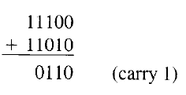
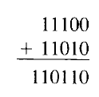
Binary Addition Example
Add two binary numbers: 11100 and 11010
Here, 1 + 1 + 1 (carry) produces 11, recorded as 1 with a carry of 1 to the next higher column

Slide 4
Binary Subtraction
Rules of binary subtraction
0 – 0 = 0
1 – 0 = 1
1 – 1 = 0
10 – 1 = 1

Slide 5
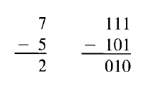
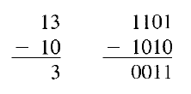
Binary Subtraction Example
Computers use different techniques for binary subtraction, as we will discuss soon

Slide 6
Signed Binary Numbers
Negative decimal numbers are -1, -2, -3, etc
For binary numbers, positive sign is 0 and negative sign is 1, so:
In binary 0001 means +1 and 1001 means -1
In binary 0010 means +2 and 1010 means -2, etc
Such numbers are called signed binary numbers or sign-magnitude numbers
Example: Express the following as 16-bit signed binary numbers:
+7, -7, +25, -25
Solution: Next slide

Slide 7
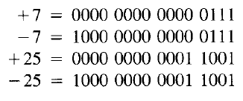
Sign-Magnitude Numbers Example

Slide 8

2’s Complement
Sign-magnitude numbers are easy to understand, but they need too much hardware for addition and subtraction
Hence, complements are used for binary arithmetic
Consider a number A = 0111
Its complement is 1000, also called as the 1’s complement of a number
The 2’s complement of a number is obtained by adding 1 to the 1’s complement of a number:

Slide 9
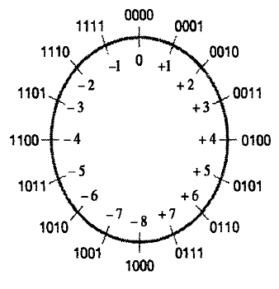
2’s Complement Example

Slide 10
Calculate 2’s Complement
A = 0111
Ā = 1000
A’ = 1000 + 1 = 1001

Slide 11
2’s Complement - Practical Usage
If we take the 2’s complement of a number twice, we get the original number back
Example:
A = 0111
Ā = 1000
A’ = 1000 + 1 = 1001
So we now start with A = 1001 now
Ā = 0110
A’ = 0110 + 1 = 0111, which was our original number
So, we can say that A’’ = A

Slide 12

Sample Binary Odometer with Negative and Positive Numbers
Double complement logic
Consider a positive number 0010 in binary, i.e. 2 in decimal
Its 1’s complement is 1101
So, its 2’s complement is 1110
1110 in decimal is -2
So, 0010 (i.e. +2) and 1110 (i.e. +2) are 2’s complements of each other
1101
1110
1111
0000
0001
0010
0011
Negative numbers
Positive numbers
Important conclusion: Taking a 2’s complement of a number is the same as changing its sign (i.e. positive to negative or vice versa)

Slide 13
2’s Complement and Binary Arithmetic
With sign-magnitude numbers, we require separate digital circuits for binary addition and subtraction
With 2’s complement, we can use a simple digital circuit to perform both addition and subtraction – how?
Consider two binary calculations: 0101 + 0010 and 0101 – 0010
Addition is simple
To perform subtraction, we take 2’s complement of the second number: 0010->1’s complement: 1101-> 2’s complement: 1110
We then add (and not subtract) the second number to the first number
Summary: We use add circuit for subtraction also – See next slide

Slide 14
2’s Complement and Binary Arithmetic
Addition
0101 (+5)
+ 0010 (+2)
-------------
0111 (+7)
Subtraction using 2’s complement
0101 (+5)
+ 1110 (-2)
-------------
0011 (+3)
Normal Subtraction would be …
0101 (+5)
- 0010 (+2)
-------------
0011 (+3)
To subtract 0010 from 0101, we first take 1’s complement of 0010, which is 1101. We then take the 2’s complement, which is 1110. We then add this 2’s complement to the first number, although this is a subtraction operation.

Slide 15
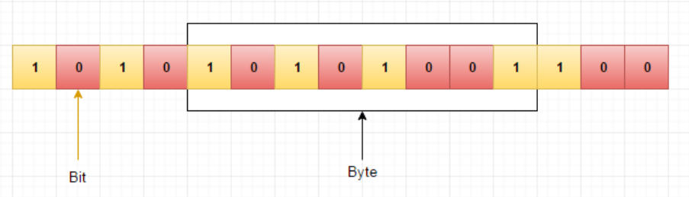
Storage of Data in Memory

Slide 16
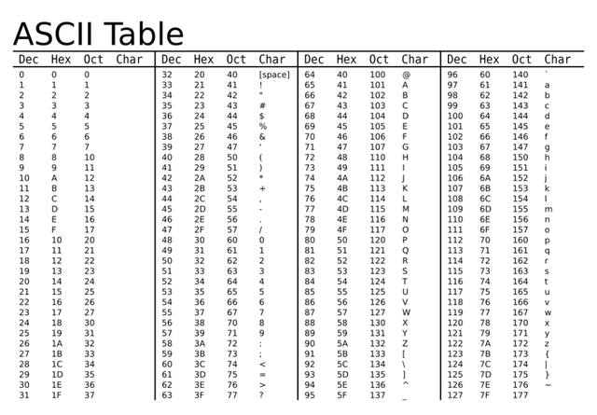
How are Characters Stored in Memory?

Slide 17
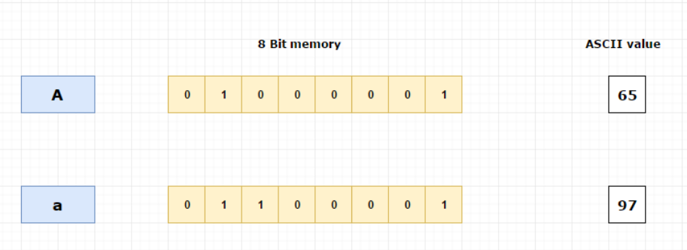
Character Storage Example

Slide 18
Integer Storage Example
Integers are whole numbers which will be stored in computer using 4 bytes (32 bit) of memory
Example: For integer 65, binary representation is 1000001
The MSB (most significant bit) bit is used to indicate whether the number is positive or negative
For positive numbers MSB will be 0
For negative numbers MSB will be 1
In our case, 65 is positive so MSB will be 0
This binary equivalent of 65 will be stored in 32-bit memory

Slide 19
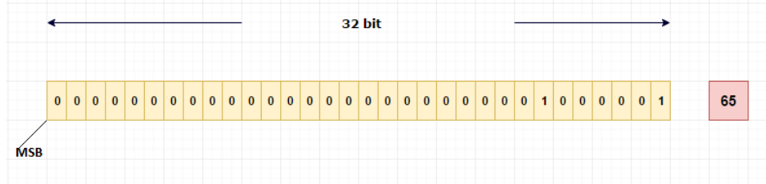
Integer Storage Example

Slide 20
Negative Integers Storage in Memory
Computer uses special mechanism to store negative numbers which is 2’s complement format
Consider a decimal number 10 - its binary value will be 1010
Represented in 32 bits, it will be 00000000000000000000000000001010
Its 1's complement will be 11111111111111111111111111110101
2's complement will be 11111111111111111111111111110110
This will be stored in the memory

Slide 21
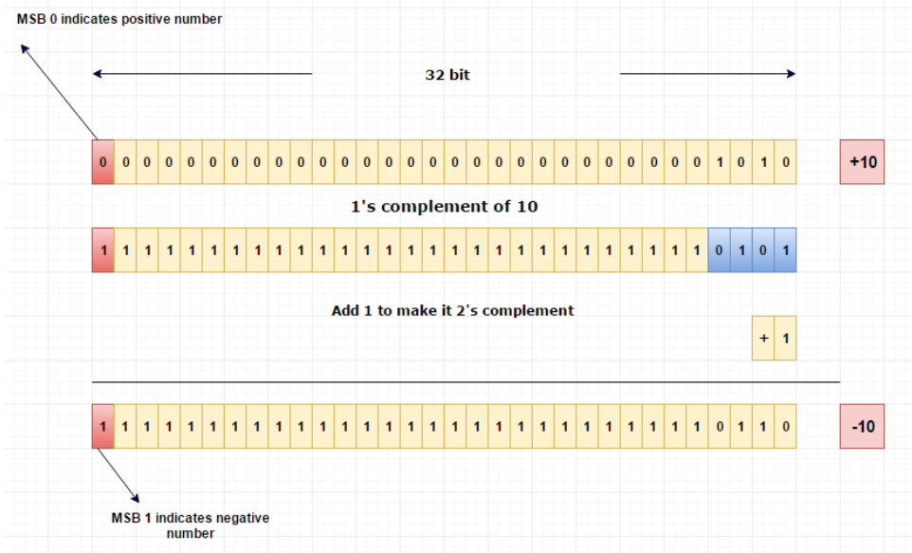
Negative Integers Storage in Memory

Slide 22
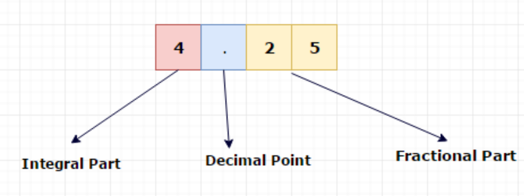
Floating Point Numbers Storage in Memory
First, we need to convert a floating point number into binary
Consider a number 4.25 in decimal
Converting the integer part: Use division
So, 4₁₀ = 100₂
To convert the fractional part to binary, multiply fractional part with 2 and take the one bit which appears before the decimal point
Follow the same procedure with after the decimal point (.) part until it becomes 1.0

Slide 23
Floating Point Numbers Storage in Memory – Step 1: Convert Decimal to Binary
0.25 * 2 =0.50 take 0 and move 0.50 to next step
0.50 * 2 =1.00 take 1 and stop the process as there is no remainder
0.25 = 01₂
Combining the integer and fractional parts, 4.25₁₀ = 100.01₂

Slide 24
Exercise
Convert decimal 10.75 into binary

Slide 25
Solution
Integer part
10₁₀ = 1010₂
Fractional Part
0.75 * 2 =>1.50 // take 1 and move .50 to next step
0.50 * 2 =>1.00 // take 1 and stop the process because there is no remainder
0.75₁₀ = 11₂
Combining the two parts:
10.75₁₀ = 1010.11₂

Slide 26
Exercise
Convert decimal 2.33 into binary

Slide 27
Solution
Integer part: 2₁₀ = 10₂
Fractional part:
0.33 * 2 =>0.66 // take 0 and move .66 to next step
0.66 * 2 =>1.32 // take 1 and move .32 to next step
0.32 * 2 =>0.64 // take 0 and move .64 to next step
0.64 * 2 =>1.28 // take 1 and move .28 to next step
0.28 * 2 =>0.56 // take 0 and move .56 to next step
0.56 * 2 =>1.12 // take 1 and move .12 to next step
0.12 * 2 =>0.24 // take 0 and move .24 to next step
0.24 * 2 =>0.48 // take 0 and move .48 to next step
0.48 * 2 =>0.96 // take 0 and move .96 to next step
0.96 * 2 =>1.92 // take 1 and move .92 to next step
0.92 * 2 =>1.84 // take 1 and move .84 to next step
0.84 * 2 =>1.68 // take 1 and move .68 to next step
0.68 * 2 =>1.36 // take 0 and move .36 to next step
0.36 * 2 =>0.72 // take 0 and move .72 to next step
0.72 * 2 =>1.44 // take 1 and move .44 to next step
0.44 * 2 =>0.88 // take 0 and move .88 to next step
0.88 * 2 =>1.76 // take 1 and move .76 to next step
0.76 * 2 =>1.32 // take 1 and move .32 to next step

Slide 28
Solution
Here, the fractional part 0.32 which is repeating again
We will not get 1.0 using this method
In floating number storage, the computer will allocate 23 bits for the fractional part. So, it is enough to stop the above method after 23 fractional digits
2.33₁₀ = 10.010101000111001011₂

